Slide 1
Government of India
Ministry of Environment, Forest & Climate Change
(MoEF&CC)
Mr. Arvind Kumar Nautiyal
Joint Secretary
&
Dr. Ritesh Joshi
Scientist

Slide 2
India: Challenges & Opportunities
Approx. 1.32 billion population
A mega-biodiverse country with only 2.4% of the world's land area
Accounts for 7-8% of all recorded species, including over 47,000 species of plants and 96,000 species of animals.
869 protected areas covering 1,65,088.36 Km² and 5.02% of the country's geographical area.
Nearly, 1.5 million schools across 707 districts in country
About 55 Ministries have been established for ease of doing business in different sectors

Slide 3
Mandate of MoEF&CC
Nodal agency for the planning, promotion, co-ordination and overseeing the implementation of India's environmental and forestry policies and programmes
Broad objectives:
Conservation of flora & fauna (Forest and Wildlife)
Prevention and control of pollution
Welfare of animals etc
To achieve its objectives a set of legislative and regulatory measures has been notified by Ministry namely:
Ministry has a strong framework and legal network of enforcement of various provisions of the regulations through Authorities, PCBs, NGT etc.
Ministry lays great importance to the informal ways of educating school/college students through its outreach programme, namely Eco-club .
Indian Forest Act 1927
Wildlife (Protection) Act 1972
Water Act 1974
Forest Act 1980
Air Act 1981
Environment Protection Act 1986
Biological Diversity Act 2002

Slide 4
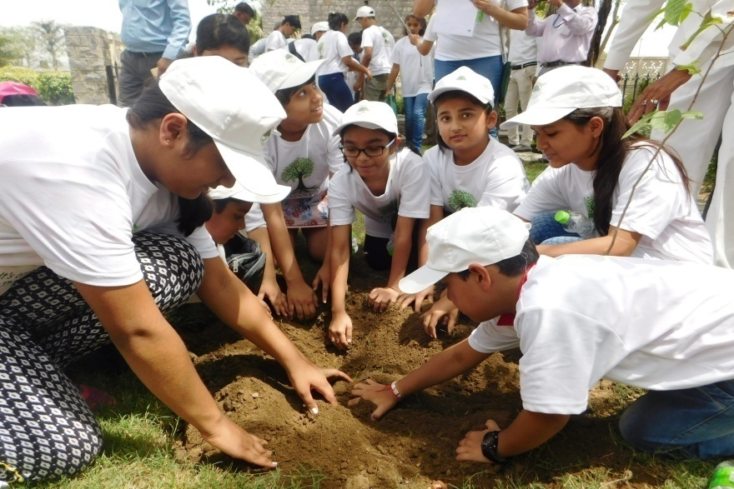
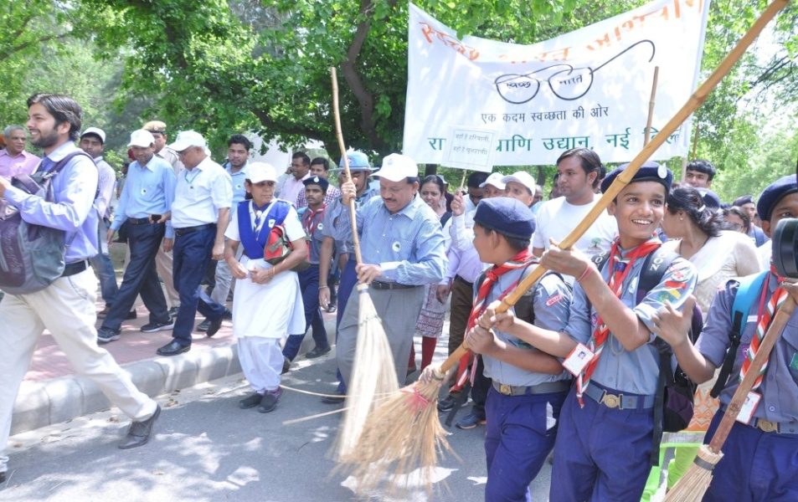
Environment Education, Awareness & Training Scheme (Central Scheme, launched during 1983-84)
Objectives of the Scheme
To promote environmental awareness among all youth through informal mode of education.
To build capacity of teachers and students on topics of Environment like biodiversity conservation, waste management, forest conservation, wildlife issues etc.
To mobilize student’s participation for environment conservation.

Slide 5
Programmes under EEAT
National Green Corps, NGC (Target group: Classes upto XIIth Class & College level)
GLOBE programme
Green Good Deeds initiative
National Nature Camping Programme, NNCP (Target group : VIth -VIIIth Class and College level)
Capacity Building programmes (Target group : students and teachers)
EEAT
NGC
Capacity Building
NNCP

Slide 6
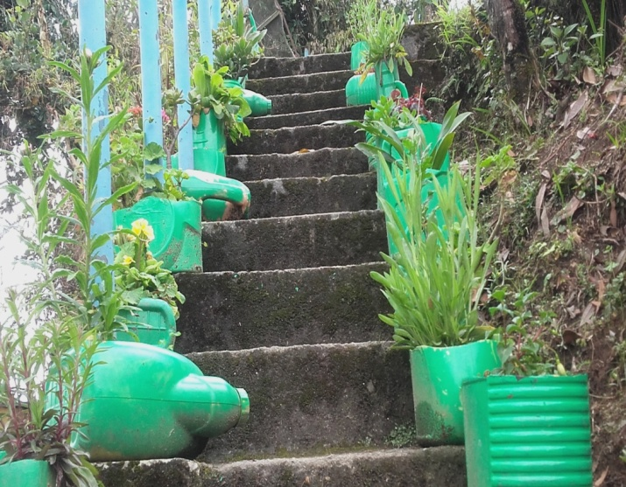
National Green Corps (NGC) “Ecoclub” Programme
Launched in 2001-2002 to spread environmental awareness.
Coverage per District increased from 250 schools in 2005-06 to 500 Ecoclubs in 2019-20.
Financial assistance increased from Rs. 2,500/- per school per annum during 2005-06 and now to Rs 5000/- during 2017-18 (~USD 80).
Reuse of plastics by Eco-clubs in Sikkim

Slide 7
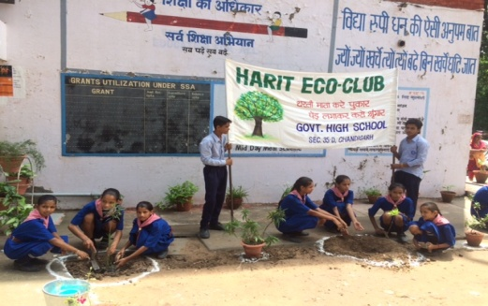
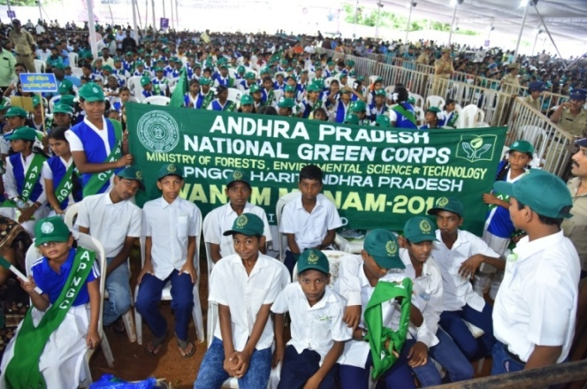
No. of Eco-clubs supported during last three years
S.No. | Year | No. of Eco-clubs
1 | 2018-19 | 75,000
2 | 2017-18 | 75,000
3 | 2016-17 | 90,000
Plantation drive
Mass awareness rally

Slide 8
Funds released to State Nodal Agencies during last three years
S.No. | Year | Funds released (in INR) | Funds released (in USD)
1 | 2018-19 | 40.00 cr | 60,00,000
2 | 2017-18 | 40.00 cr | 60,00,000
3 | 2016-17 | 48.00 cr | 72,00,000
During 2019-20, there is budget of Rs 50 cr (71,37,250 USD)

Slide 9
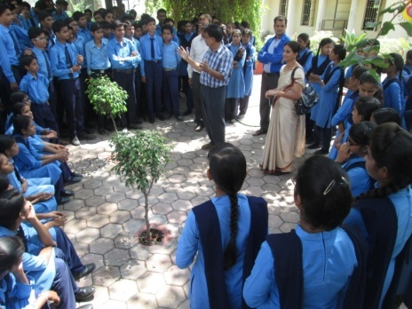
Activities being undertaken
Awareness on solid waste management through waste segregation (biodegradable and non-biodegradable); establishing 2-Bins in schools– (1) Blue Bin for dry waste like Paper waste, Glass waste, E-waste and (2) Green Bin for wet waste.
Plantation drives.
Celebration of important environmental days in schools such as World Environment Day, World Wetland Day, Earth Day, etc.
Cleanliness drives

Slide 10
“Prakriti Khoj – online Environment Quiz”
Ecoclub students participate in this quiz (multiple choice questions) which is a fun filled interactive learning mode for triggering a sense of awareness towards environment protection and conservation. (three age group categories i.e. 8-12 year, 13- 15 year and 16-18 year).

Slide 11
‘Green Pledge’
I shall do my best to protect the Earth and its natural environment.
I shall adopt such practices that would minimize wastage.
I shall reuse whatever I can.
I shall reduce the waste we create.
I shall take care to clean up the environment.
I shall plant more trees.
I shall conserve energy and water.

Slide 12
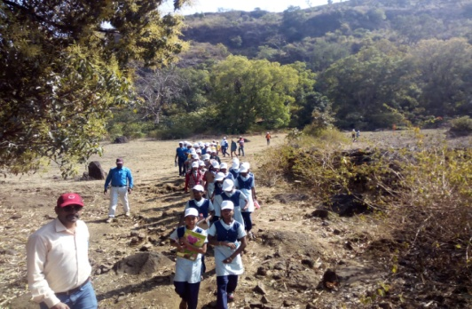
National Nature Camping Programme (NNCP)
Under this programme field visits (nature camps) are organised in different protected areas of India.
Maximum no. of camps to be supported per State/UT is 20.
The following activities are undertaken:
‘Apna Paryavaran Janiye’ (Know your Environment) by preparing small checklist of flora and fauna seen/spotted by them in the nature trail,
Bird watching
Trekking
Green Pledge
Group Discussion involving record/sharing of experiences and
Other nature based activities
Nature trail

Slide 13
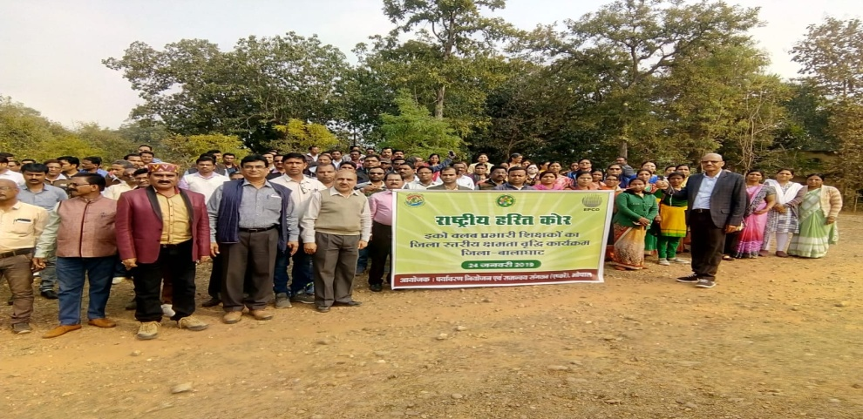
Capacity Building Activities
Trainings to teachers and students on themes of MoEF&CC.
Duration: 1-2 days in batches of 30
A financial assistance of Rs 5 lakhs (USD 7000) for five trainings.
The cost cover :
Travel
Resource toolkit
Logistics (Food and accommodation)
Honorarium to Resource Person
Miscellaneous
Capacity building workshop

Slide 14
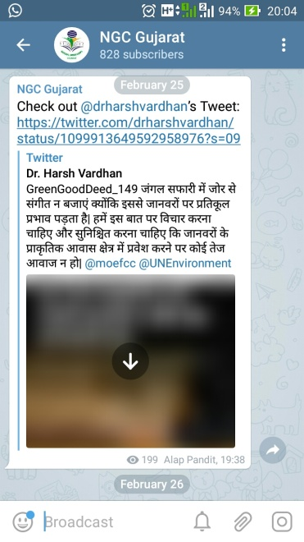
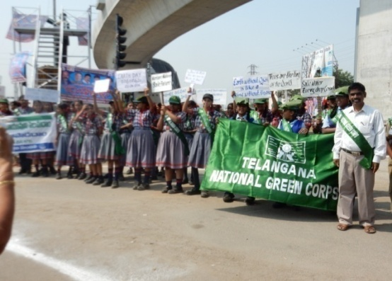
IMPACT
A network of about one lakh Eco-clubs at school & college level has been developed which will be increased to about two lakh during 2019-20.
In order to make the youth aware about environment friendly initiatives, Green Good Deeds initiative launched by the Ministry.
Ecoclubs encouraged to take up small, little, green deeds towards environment protection in their day to day life and adopt Green Good Behaviour.
Communications through watsapp group
Mass Awareness rally

Slide 15
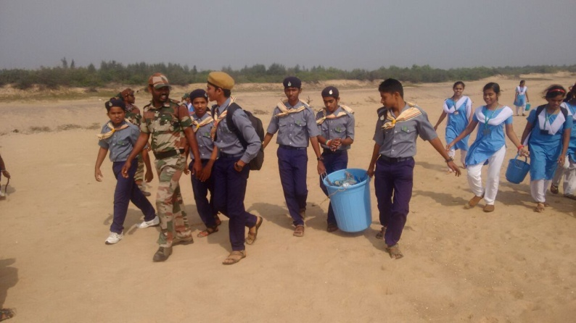
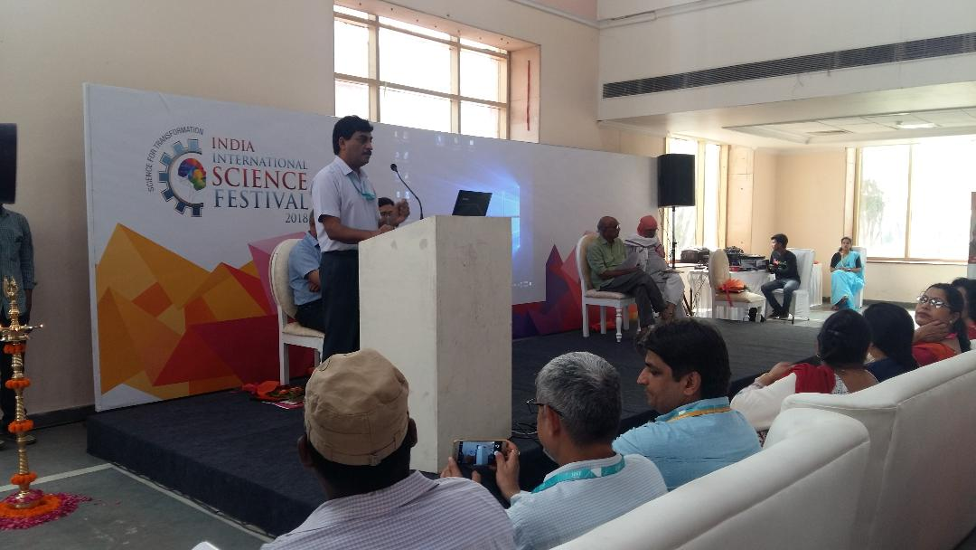
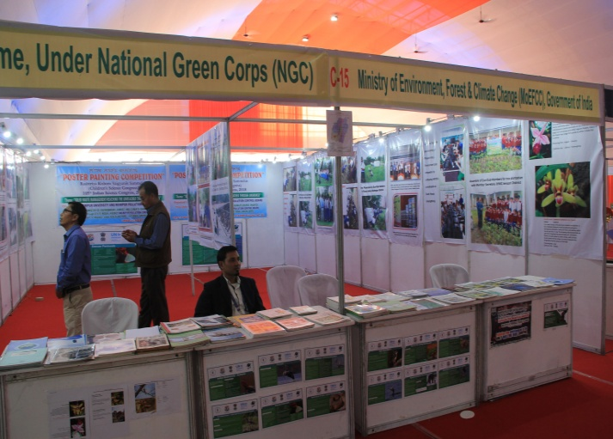
Success Stories
Beach cleaning and riverfront cleaning programme successfully conducted on occasion of the World Environment Day- Beat Plastic pollution 2018
GREEN GOOD DEEDS event was successfully organized by EE Division, MoEF&CC in collaboration with the nodal agency at 4th India International Science Festival (IISF) 2018 held at Indira Gandhi Prathishthan, Lucknow
Exhibition on NGC Programme on behalf of Ministry successfully organised in the 105th Indian Science Congress held At Manipur University, Imphal, Manipur 2018

Slide 16
Restructuring of the GLOBE programme
Programme has been restructured since the financial year 2017-18.
4 meetings held with US Embassy officials.
Meetings have been organized with States.
Administrative approval has received. Financial implications have been worked out.
Convergence of Ecoclub programme with GLOBE programme, so that as like Ecoclub programme, nearly 1 lakh (0.1 million) GLOBE schools can be established.

Slide 17
GLOBE Programme Plan of Action
Nearly 750 schools proposed to be made active 2019-20 in five States (one from each region North, South, East, West and Central India)
Madhya Pradesh,
Kerala,
Odisha,
Rajasthan and
Gujarat
Rs 20 lakh (29,000 USD) for each State shall be allocated by Government of India to conduct GLOBE

Slide 18
MoEF&CC
Madhya Pradesh
Odisha
Kerala
Gujarat
Rajasthan
District level functionaries
(DEOs)
750 schools and 30,000 students
Five trainings in each State
(150 schools in each State )
For imparting training on the GLOBE protocols to States, services of GLOBE Asia-Pacific Regional Coordination Office which is at Indian Environmental Society, New Delhi shall be utilized

Slide 19
GLOBE Activities in India
2018-19
Trainings to teachers under Zika Education and prevention project
The aim of the training was to build capacity of teachers on the awareness on the Zika virus.
Recognize potential mosquito breeding sites
Sample water for mosquito larvae
Identify mosquito larvae and differentiate between Aedes, Anopheles, and Culex larva.
Understand the importance of removing containers with standing water from mosquito use around your neighborhood and community
Nearly 200 students/teachers, participated.
Four trainings held in Delhi Madhya Pradesh, Gujarat and Haryana.
Remaining 2 trainings are scheduled to be completed by June 2019.

Slide 20
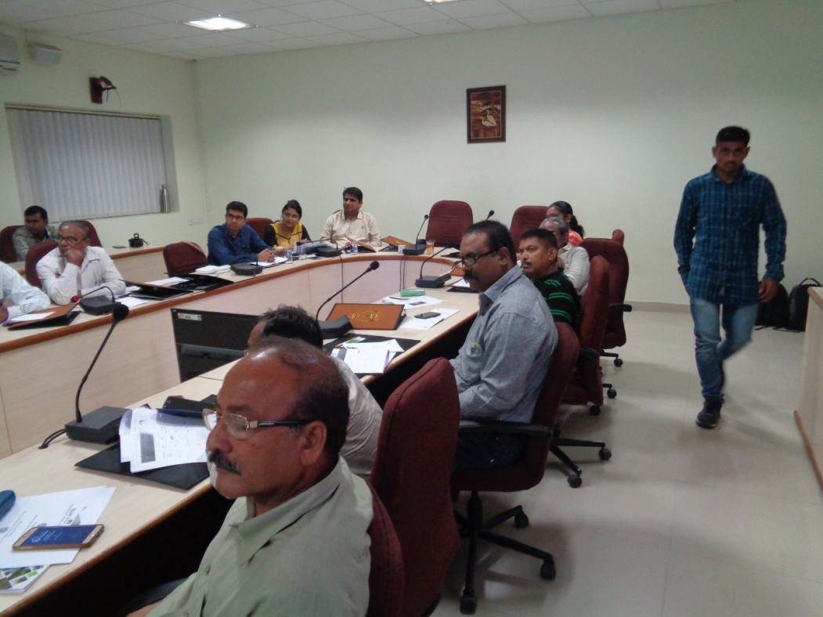
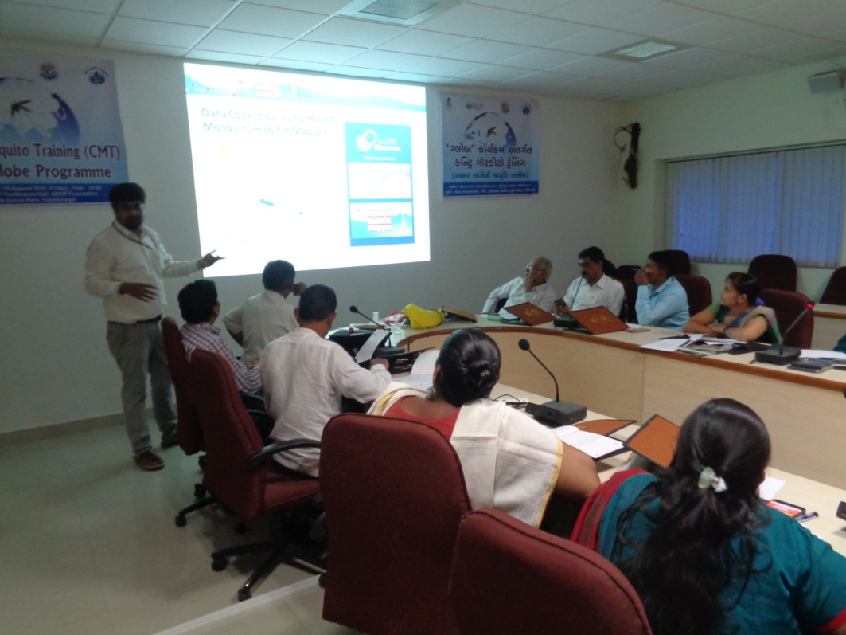
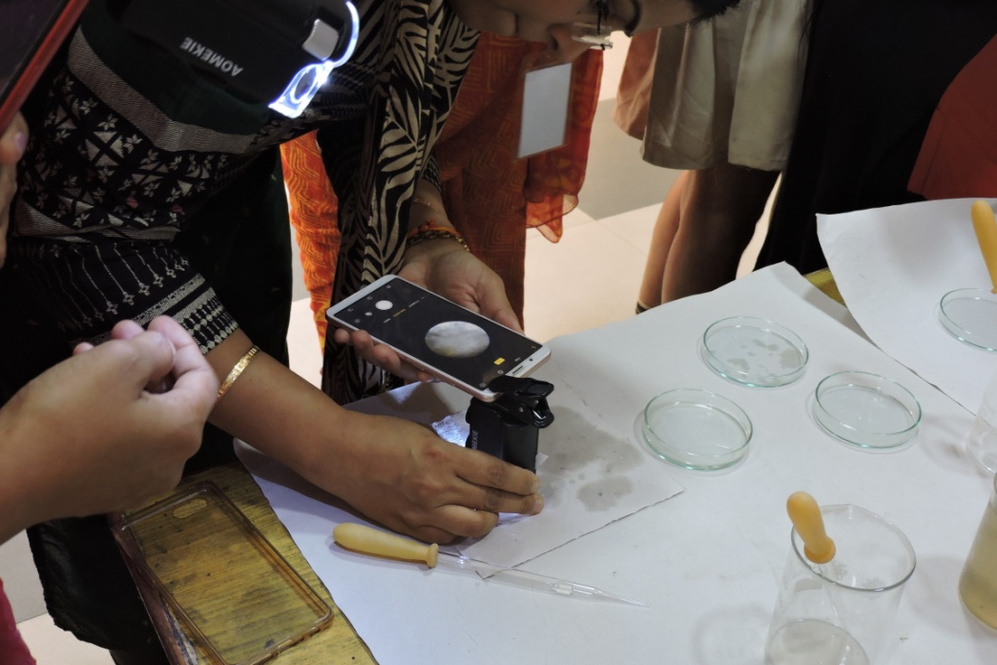
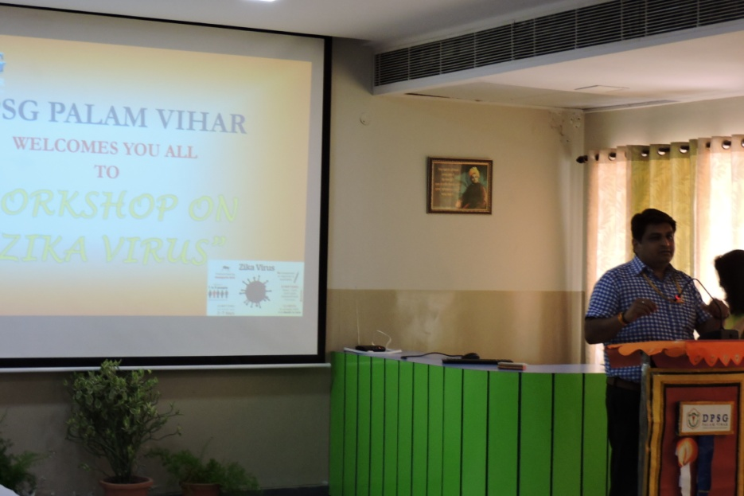
Glimpses of trainings under Zika Prevention and Education project

Slide 21
Thank You

